Slide 1

Feature Engineering

Slide 2
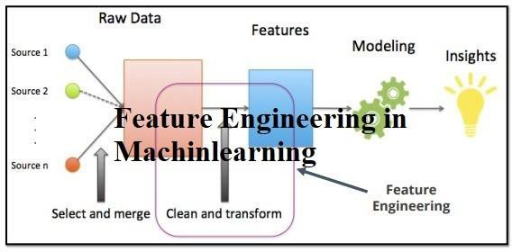
Feature Engineering

Slide 3
Feature Engineering
Data Cleaning and Preprocessing
Handling Missing Values: Strategies include imputation, deletion, or using models to predict missing values.
Dealing with Outliers:
Feature Creation
Derived Features: Creating new features from existing ones, like combining, binning, or polynomial features.
Domain Knowledge Incorporation: Utilizing domain expertise to craft features relevant to the problem. Feature Scaling and Normalization

Slide 4
Scaling Numerical Features: Ensuring features are on a similar scale (e.g., Min-Max scaling, Standardization).
Normalization: Bringing features to a standard scale to aid model convergence. Handling Categorical Variables
One-Hot Encoding: Transforming categorical variables into binary vectors.
Label Encoding: Converting categorical values into numerical labels.
Feature Selection/Extraction
Removing Redundant Features: Eliminating features that do not contribute significantly to the model.
Techniques: Filter, wrapper, embedded methods, and dimensionality reduction

Slide 5
4. Handling Categorical Values
One-Hot Encoding
Label Encoding
Ordinal Encoding
Target Encoding (Mean Encoding)
Frequency Encoding

Slide 6
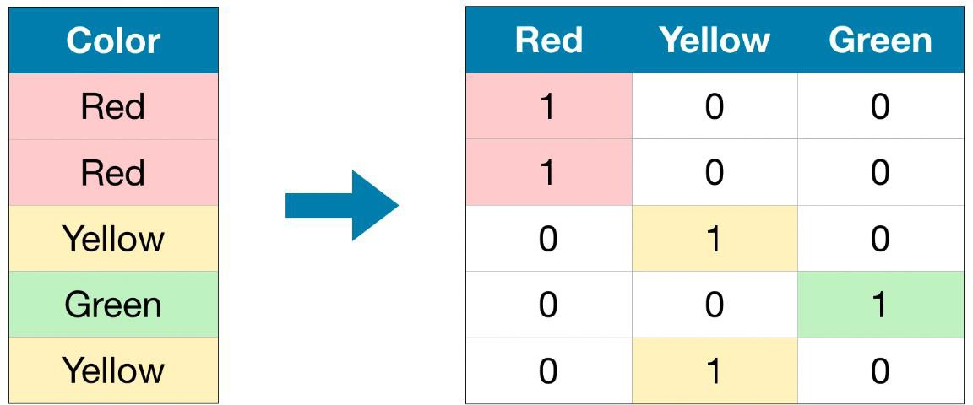
One hot encoding
Each category is transformed into a binary vector where only one element is 1 (hot) while the others are 0 (cold)

Slide 7
One hot encoding
Predict customer preferences based on demographic data.
Categorical Variable: 'Region' with categories 'North,' 'South,' 'East,' 'West

Slide 8
One hot encoding
Predict customer preferences based on demographic data.
Categorical Variable: 'Region' with categories 'North,' 'South,' 'East,' 'West
Advantages:
Preserves information without imposing ordinality.
Compatible with various machine learning models.
Considerations:
May lead to a high number of features in cases with many
categories
Original Data | Is_North | Is_South | Is_East | Is_West
North | 1 | 0 | 0 | 0
South | 0 | 1 | 0 | 0
East | 0 | 0 | 1 | 0
West | 0 | 0 | 0 | 1

Slide 9
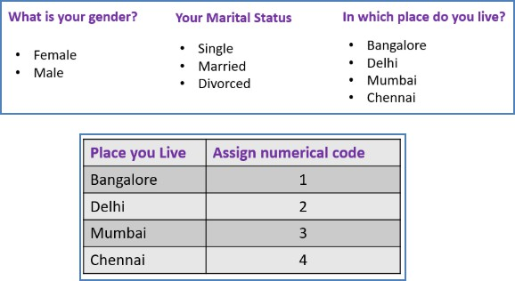
Label Encoding
Assigns a unique integer to each category.
Example: Assigning integers 0, 1, 2 to 'red,' 'blue,' 'green' respectively.
Advantages:
Simple and easy to implement.
Reduces dimensionality compared to
one-hot encoding.
Considerations:
Imposes ordinality, which might be misleading for some categorical variables.

Slide 10
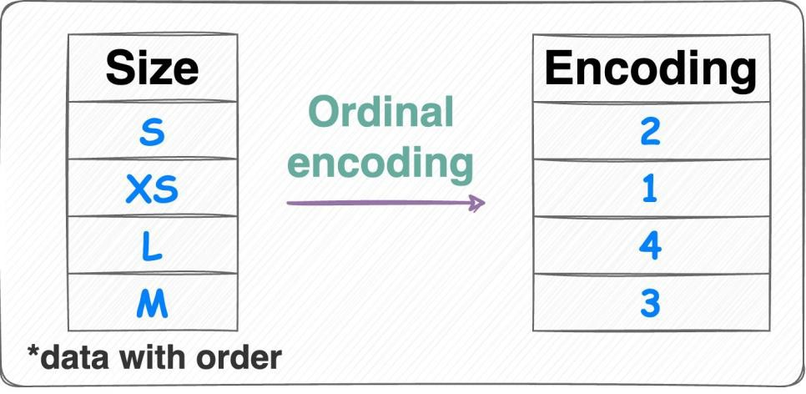
Ordinal Encoding
Assigns integers based on the order of categories (relevant for ordinal variables).
Example: 'Low,' 'Medium,' 'High' encoded as 0, 1, 2 respectively

Slide 11
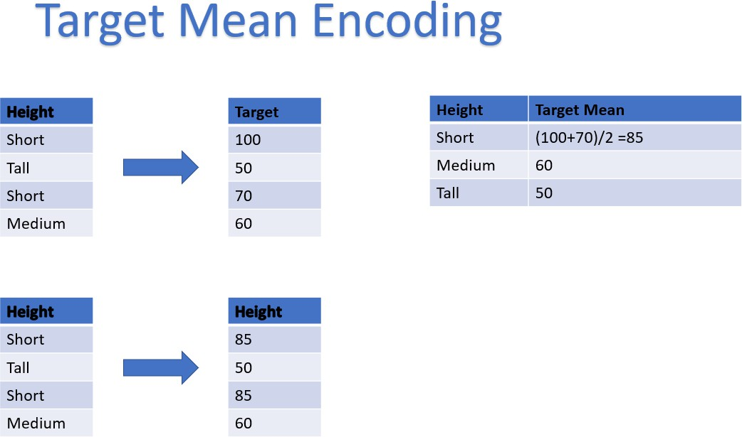
Mean/Target Encoding
Uses the target variable's mean to encode categories.
Example: Replacing categories with the mean of the target variable for that category.

Slide 12
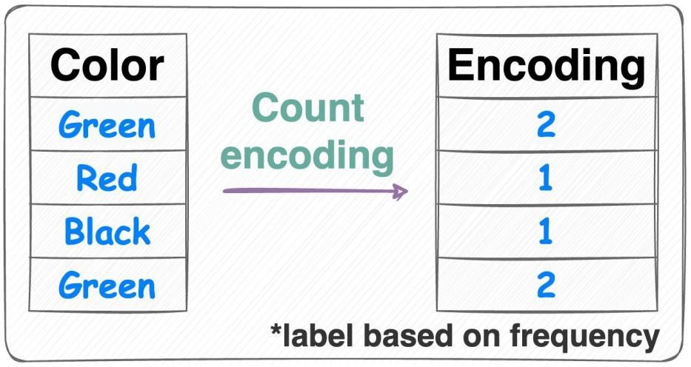
Frequency Encoding
Encodes categories based on their frequency in the dataset.
Example: Replacing categories with their occurrence count.

Slide 13
5. Feature Selection
Feature selection involves choosing a subset of relevant features for use in model construction.
Importance: Reduces dimensionality, improves model performance, mitigates overfitting, and enhances interpretability
Forward Selection: Adds features one by one until no improvement in model performance.
Backward Elimination: Starts with all features and progressively eliminates the least significant.

Slide 14
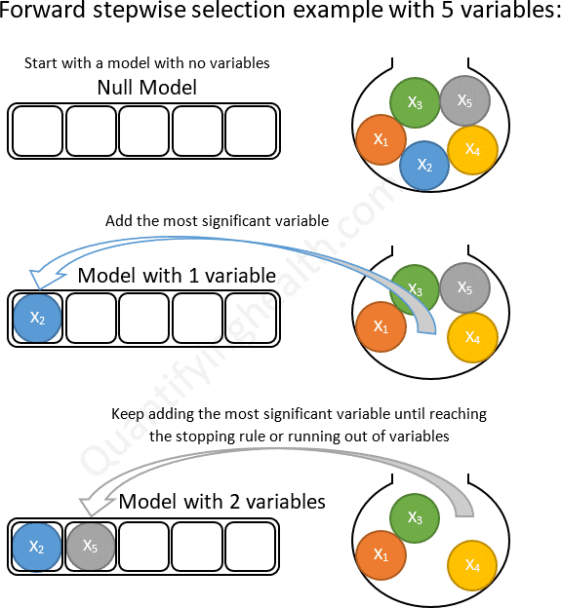
Forward Selection
Initialization: Start with an empty set of features.
Iteration:
a. Step 1: Train the model using each individual feature separately and select
the one that performs the best based on a chosen evaluation metric (e.g., accuracy, F1 score, etc.) on a validation set through cross-validation.
Model 1: Train using only the 'age' feature.
Model 2: Train using only the 'income' feature. Model 3: Train using only the 'gender' feature.
b. Select the Best Feature: Choose the feature that yields the highest performance metric (e.g., accuracy) among all the models.
c. Add the Best Feature: Add the selected feature to the set of chosen
features.
d. Iterate: Repeat steps (a) through (c) until adding more features does not significantly improve the model performance.
Final Model: Use the selected set of features to train the final model.

Slide 15
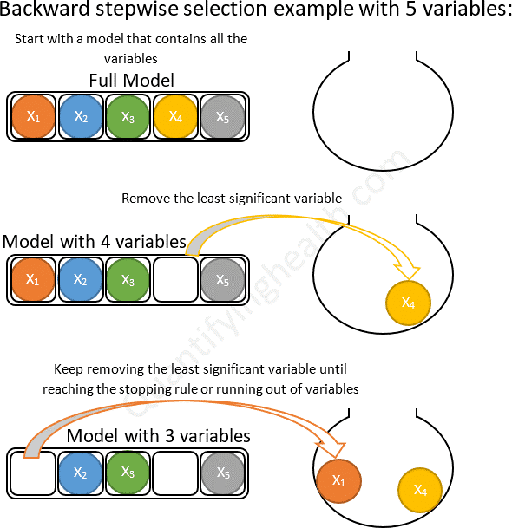
Backward Elimination
Initialization: Begin with all available features included.
Iteration:
a. Step 1: Train the model using all features.
b. Evaluate Model: Assess the performance of the model using a chosen evaluation metric (e.g., mean squared error, R-squared) on a validation set through cross-validation.
c. Remove One Feature: Remove one feature (one at a time) from the set of features and train the model again without that particular feature.
d. Evaluate Model without Feature: Evaluate the performance of the updated model (without the removed feature) using the same evaluation metric.
e. Criterion for Removal: Remove the feature whose absence causes the least impact or degradation in the model's performance.
f. Iterate: Repeat steps (a) through (e) until further removal of
features does not significantly degrade the model's performance or until a predefined stopping criterion is met.
Final Model: Use the selected subset of features to train the final model.

Slide 16
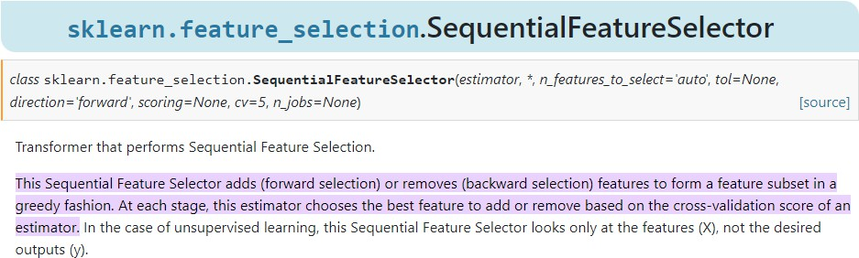
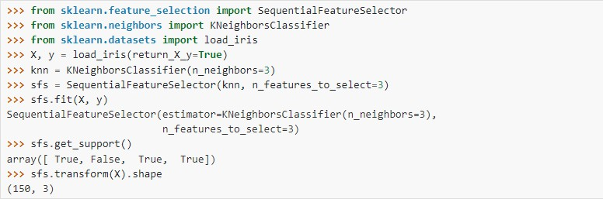

Slide 17
https://www.kaggle.com/code/jurk06/forward-and-backward-subset- selection-method

